Slide 1
C# - SELECTION AND REPETITION

Slide 2
Programming Control Structures - Conditions
Often we want to solve problems based on some conditions
Eg: has the player been hit by a bullet? Or is the bank account below $0
These conditions will always resolve to be either TRUE or FALSE
This is called a Boolean value

Slide 3
Comparison conditions
We will compare two values using the following
> Greater than
>= Greater than or equal to
< Less than
<= Less than or equal to
== Equal to
!= Not equal to
Query?
What is the difference between > and >=
Think about: “If you are 16 years and over you can apply for your learners licence”

Slide 4
IF – Conditional Expression
An if is used to determined whether the next statement(s) will run.
When the statement results in a TRUE value they will run
If the statement is FALSE then they won’t run

Slide 5
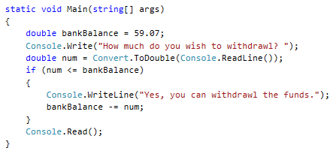
IF – Conditional Expression
One line result
More than one line (block result)

Slide 6
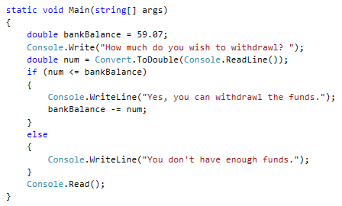
IF / Else – Conditional Expression
When the IF statement results in a FALSE it can run an ELSE block

Slide 7
Boundary cases
In your planning stage you should be clear about the difference between > and >=
For example: when purchasing flights children 12 and over must have an adult ticket
This sounds really similar to “children over 12 must have an adult ticket”
Careful testing should be done to ensure the boundary cases are correct
What are the boundary test cases for this example?
11,12,13

Slide 8
Try this… “Who wins”
Ask the user for two inputs –rugby scores for two teams
Compare the results and announce who won.
Add an addition feature…
In the school rugby sweepstake people who guess the score within 3 points (either side) get a bonus point.
Also tell the user what scores they needed to guess.
Eg: “If you guess between x and x you get a bonus point”
Eg: if the score was 20 they could have guessed 17 - 23

Slide 9
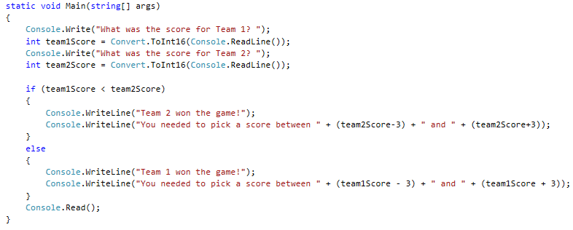
An answer
Test your program for if they score a try. What happens? See next slide about this

Slide 10
If… ElseIF … Else
We can have more conditions in our statement. For the previous example we may want to check for the DRAW game case.
Our plan my look like:
If (team1Score == team2Score)
print message “It was a draw”
ElseIf (team1Score < team2Score)
print message “Team 2 won”
Else
print message “Team 1 won”

Slide 11
Try this:
In NZ when you are caught driving over the speed limit you are given demerit points, once you reach 100 points or more you lose your drivers licence. Create a program which asks the user what the speed limit is and the speed the offender was going. It then prints out how many demerit points they are given for this offence.
The following is a summary of the demerit points for speeds.
Speed (over the limit) | Points
Less than 10 km/h | 10
11-20 km/h | 20
21-30 km/h | 35
31-35 km/h | 40
More than 35 km/h | 50
Notes:
https://www.nzta.govt.nz/driver-licences/driving-offences-and-penalties/demerit-points/#speed

Slide 12
Checking two conditions at once
There are 3 logical operators which can be used in a conditional statement these are:
Logical AND && (both statement must be true)
Logical OR || (one statement must be true)
Logical NOT ! (statement isn’t true)
Imagine the conditions:
The school pool is only used on Fridays, some weeks you have PE on a Friday and some you don’t. Check if its Friday AND you have PE
The game character explodes when it hits a wall OR a tree
The person gets an email if they have NOT paid.

Slide 13
Try this
How many ways can you write:
points > 9 && points < 11
assume that points is always an Integer
There are no right or wrong answers to how you code this. Sometimes its better to have more code if it makes it clearer to read.
Notes:
Some answers to this may be:
Points == 10
Points >=10 && points <= 10

Slide 14
Testing
You should always test your programs on a range of cases. Formal testing, such as for your assessments, may require documentation.
For large programs which require several inputs you should write test cases for every input occasion.
Below is an example of how you might test “On a school day my alarm goes off at 6am on a weekend my alarm goes off at 8am, when I enter the day (a number 1-7, 1 being Monday) the program tells me what time to set my alarm”
 | Input | Expected output | Actual Output
Expected | 2 3 | 6am 6am
Boundary | 1 6 7 8 | 6am 8am 8am Enter again
Invalid | a 10 | Enter again Enter again

Slide 15
Repetition – Iterative structures
There are types of iterative structures we are going to cover:
while
for
These both will execute a block of code for the number of times the condition is true.
Eg:
while (playerHealth > 0 ) - keep going until the health drops to 0 or below
for (weeks=0; weeks<=52; weeks++) - count weeks until weeks have reached 52
What does weeks++ do?
It increments weeks by 1.
The same as weeks = weeks + 1

Slide 16
Try this
Record the total number of RSVP’s for the event. Each RSVP slip has the number from that family attending the event. Stop recording when the person enters 0
Entries will be positive integers (until 0 is entered)
How many RSVP’s? 4
How many RSVP’s? 3
How many RSVP’s? 5
How many RSVP’s? 0
Total RSVP’s is: 12

Slide 17
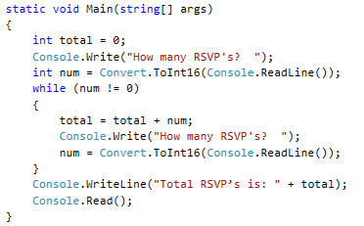
Model Answer

Slide 18
For loops
for (weeks=0; weeks<=52; weeks++) - count weeks until weeks have reached 52
The integer variable which is use in the for loop acts as a counter
For loops have 3 inputs:
starting value
ending value
increment
The variable is incremented by the “Increment amount” after each execution of the block

Slide 19
Try this
Design and write a program which uses a FOR loop to ask for integer values from the user, calculate the total and average. How many values are to be averaged is the first thing the user is asked for.
How many numbers to be averaged? 3
Enter number 1: 10
Enter number 2: 12
Enter number 3: 13
Total is 35
Average is 11.66667
Can you remember how to display numbers to just 2 decimal places?

Slide 20
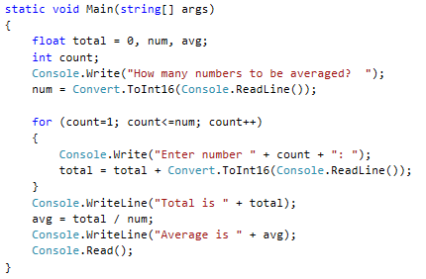
Model Answer
It would be better practice to use the ReadInt method to do input checking.

